Slide 1



IBM EMPLOYEE ATTRITION ANALYSIS
PRESENTED BY :-
PRERNA RAJ
(DATA ANALYST)
Notes:
[Begin with a warm and confident tone.]
Hello everyone, I'm Olivia Wilson, and I'm excited to be here today to talk about our business project.
[Pause briefly to connect.]
Let's start by diving into the heart of our content. Our project is designed to address specific industry needs while also fostering innovation and growth.
[Emphasize the importance of understanding the project's core.]
It's crucial that we all share a clear understanding of what this project entails, as it forms the foundation for our upcoming discussions on values, goals, and the timeline of our initiatives.
[Pause slightly to let that sink in.]
In the next slides, I'll provide an overview of our values and goals, as well as delve into more detailed aspects like statistics and market analysis.
[Conclude with enthusiasm.]
I'm looking forward to exploring these exciting developments with you. Let's get started!

Slide 2








This project presents a comprehensive analysis of employee attrition by investigating key workplace factors.
Overview
The primary objective is not only to predict which employees are at risk of leaving but to deeply understand the drivers of attrition within an organization.

Slide 3




01
Problem Statement
High employee attrition poses a significant challenge for organizations leading to
high costs
talent loss
and business disruption
Simply predicting who will leave isn’t enough — we must understand why they leave
HR teams need data-driven insights to identify risk patterns early

Slide 4


02
Goal & Objective
Objective :
Map attrition patterns using real HR data
Identify the factors that silently drive churn
Not just count leavers, but explore why they left
Visualize trends that numbers alone can’t reveal
Predict future attrition using ML
Guide HR with insights they can act on
Goal : To move beyond prediction and expose the real forces behind attrition—so organizations can respond with clarity, not guesswork.

Slide 5
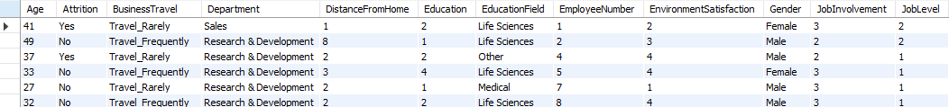
03
Dataset Description
Aspect | Details
Source | IBM HR Analytics Employee Attrition Dataset
Total Records | 1,470 employees
Target Variable | Attrition (Yes / No)
Count of Features | 35 columns
Key Categories | Demographics Job Role Income & Satisfaction Work Habits
01
02
03
04

Slide 6
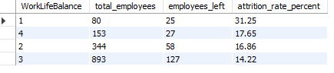
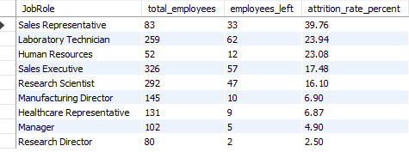
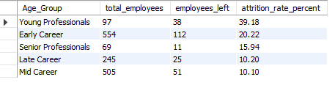
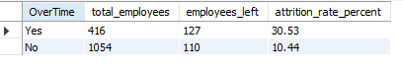
05
Attrition Rates Analysis
Using SQL, we analyzed how attrition rates vary across key employee attributes
Attrition was highest with Low or Medium WorkLifeBalance
Sales Representatives and Lab Technicians showed highest churn
Younger employees (<30) showed highest attrition
Employees working overtime had 3x higher attrition

Slide 7
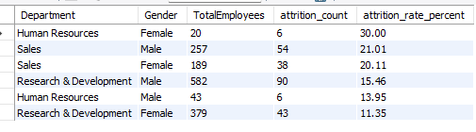
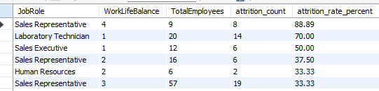
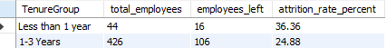
Female employees in HR have the highest attrition rate: 30%
Followed by Male and then Female Sales employees.
06
Combined Feature Insights
Attrition among Sales Reps with high WLB (4) is shockingly 88.9% — likely due to small sample or misperception.
Employees in Low or Medium WLB zones across Sales and Lab roles face 33–70% attrition.
Work-Life Balance matters — but job expectations may override it in some roles.
Employees with <1 year at the company show 36% attrition.
Early attrition signals issues in onboarding, expectation mismatch, or culture fit.

Slide 8
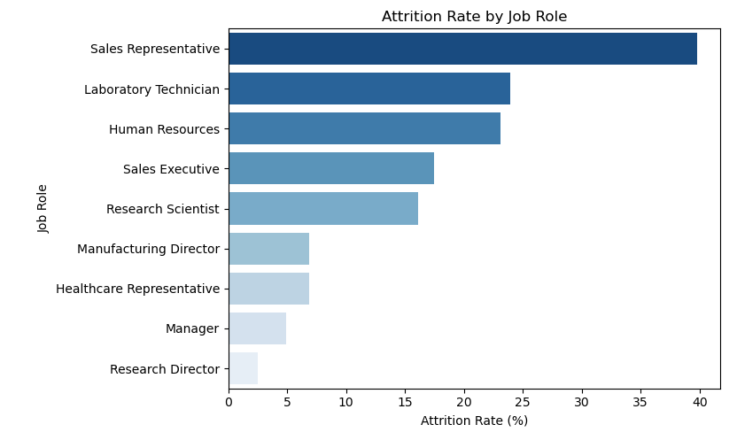
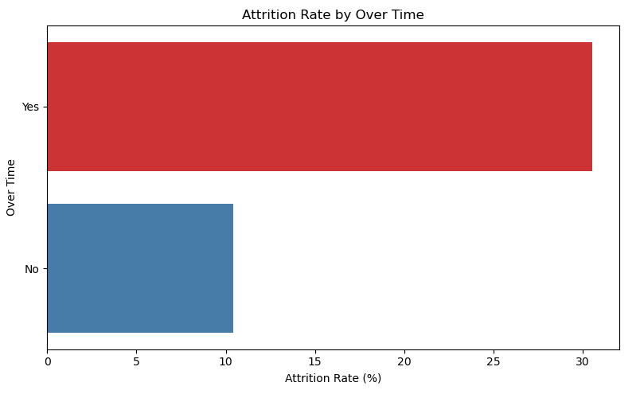
Visual Exploration
07
Sales Representatives and Lab Technicians show the highest attrition risk among all roles.
Employees working overtime are nearly 3x more likely to leave the organization.

Slide 9
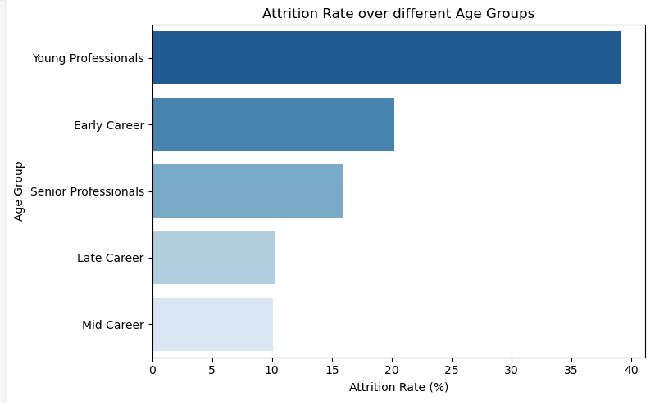
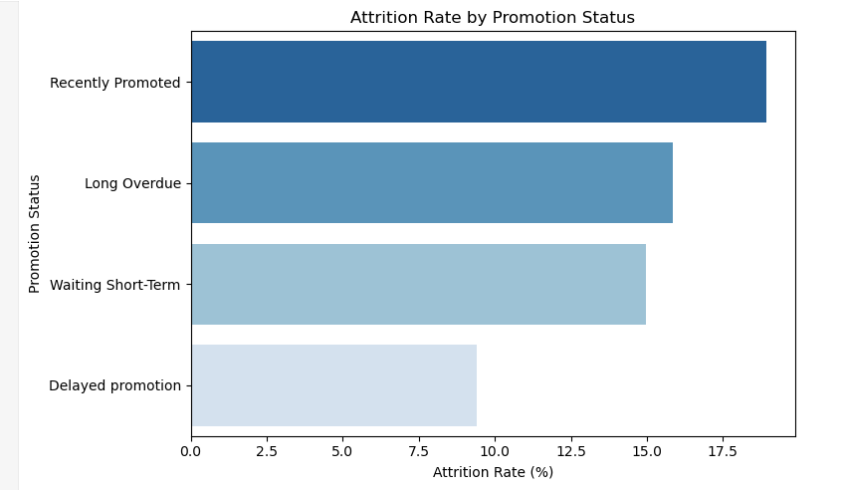
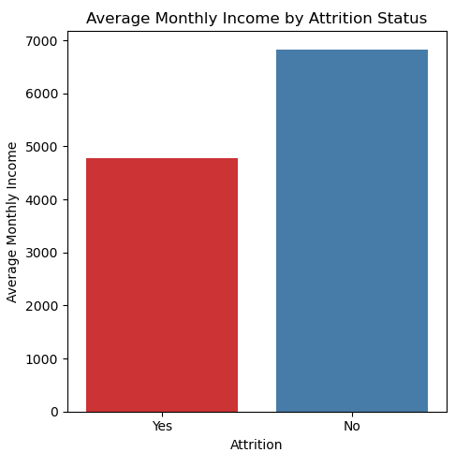
Younger employees (early in their career) are more prone to attrition.
Employees recently promoted have the highest attrition.
Promotion isn’t Retention
Employees may leave even after promotion –
Burnout from long periods of overperformance
Mismatch between expectations and new role responsibilities
Inadequate pay raise or perceived lack of value
Promotion makes them more marketable for better opportunities
Attrition is more common among employees with lower income levels.

Slide 10
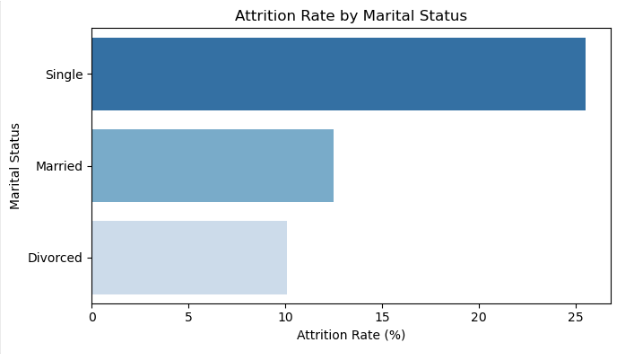
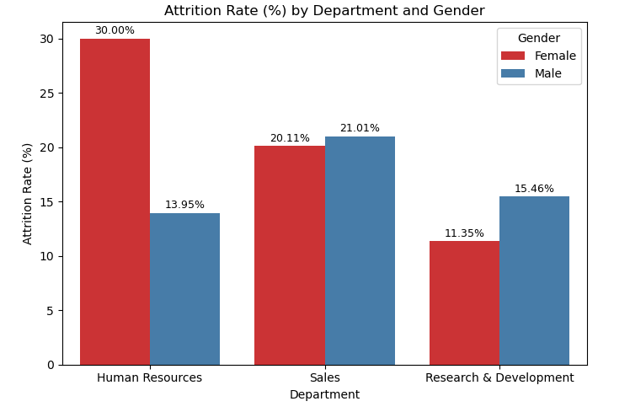
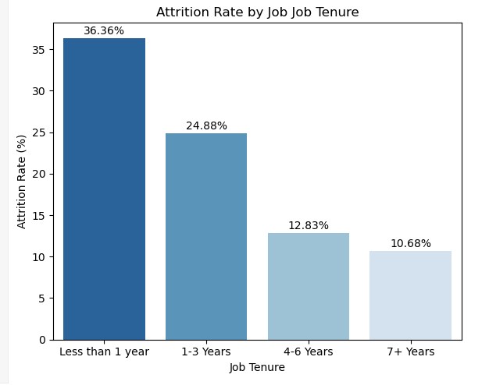
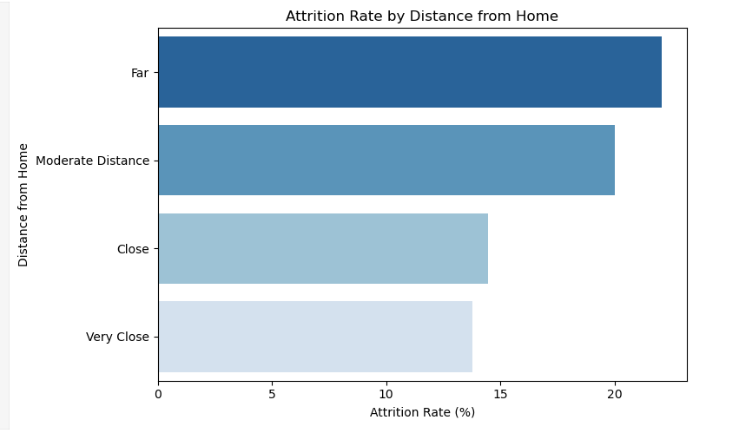
Females in HR Dept. show the highest attrition rate, followed by male employees in Sales — indicating role-gender churn patterns.
Single employees are the most likely to leave, suggesting life stage may influence career mobility.
Employees with less than 1 year of service show the highest attrition — pointing to early dissatisfaction or poor onboarding.
Attrition risk increases as commute distance grows — employees living farther are more likely to leave.

Slide 11




08
HR Insights – What the Data Says?
At-Risk Employee Profile
Satisfaction, Income & Overtime
Role & Departmental Trends
Early-tenure employees, working overtime, in Sales/Lab roles, earning low income show the highest attrition risk.
Low satisfaction and overtime are top churn indicators. Low income amplifies risk.
Highest attrition seen in Sales, Lab Technicians, and HR roles.

Slide 12



HR Insights – What the Data Says?
Frequent Travel Impact
High-Risk Combinations
Retention Through Growth
Yes, frequent travelers show elevated churn, likely due to burnout.
Overtime + low income, early tenure + no promotion = high attrition signals
Timely promotions, training access, and post-promotion clarity help improve retention.

Slide 13





09
Machine Learning Approach
Step 1: Data Preparation
Cleaned and transformed features using OneHot Encoding
Step 2: Train-Test Split & Imbalance Handling
Split data into 80:20 ratio
Step 3: Model Building
Trained multiple models to compare the performance
Step 5: Evaluation & Selection
Evaluated models using business-relevant metrics
Step 4: Ensemble Modeling
Combined Random Forest & XGBoost using SoftVoting

Slide 14
10
Model Comparison & Performance Summary
Model | Accuracy | Precision (True) | Recall (True) | F1 Score | ROC-AUC
Logistic Regression | 0.68 | 0.30 | 0.79 | 0.44 | 0.79
Naive Bayes | 0.50 | 0.20 | 0.70 | 0.31 | 0.65
Random Forest | 0.78 | 0.29 | 0.89 | 0.44 | 0.79
XGBoost | 0.84 | 0.51 | 0.49 | 0.50 | 0.81
Ensemble (Final) | 0.79 | 0.40 | 0.72 | 0.52 | 0.82
GLOSSARY
Precision (True) Out of all employees predicted to leave, how many actually left?
Recall (True) Out of all employees who actually left, how many did the model catch?
F1-Score A balanced score that considers both precision and recall.
ROC-AUC Curve Shows how well the model distinguishes between leavers and stayers. (The closer the AUC is to 1, the better the model.)

Slide 15
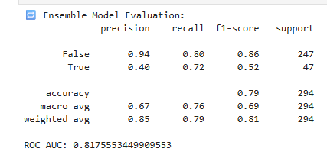


11
Final Ensemble Model
Model Composition
Combined predictions from XGBoost and Random Forest using soft voting ensemble strategy.
WHY ENSEMBLE ?
BUSINESS IMPACT
Merges strengths of both tree-based models
Improved generalization and reduced bias
Balanced performance across precision, recall & AUC
The model helps HR proactively identify at-risk employees and act early to retain top talent.
High recall ensures minimal leavers go undetected
Designed to support real-world HR interventions

Slide 16
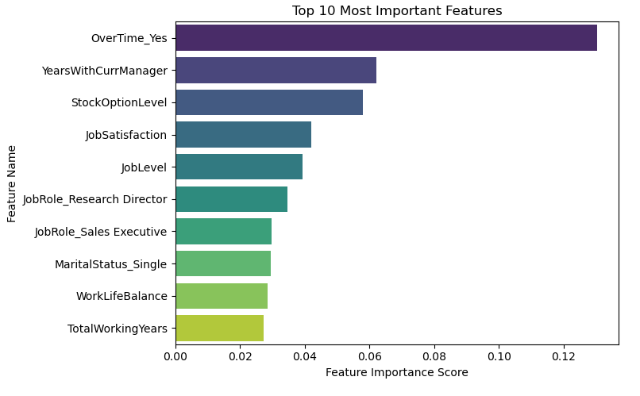
12
Feature Importance
Understanding which factors contribute most empowers HR to make smarter, data-backed decisions.
Key Observations:
OverTime is the top attrition driver
Managerial relationship matters
Stock Option Level influences retention
Low Job Satisfaction signals early churn
Single employees show higher attrition
Work-Life Balance is also critical
Overall work experience plays a role

Slide 17




Business Recommendations
13
Limit Overtime for Sales Representatives High attrition (88.9%) among Sales Reps with high overtime suggests a need for strict caps and shift rotation policies.
Address Low Work-Life Balance in Technical Roles Offer Lab Technicians and Sales Executives with WorkLifeBalance scores of 1–2, with remote days and no-meeting blocks.
Intervene Early for New Joiners (<1 Year) Introduce a 90-day check-in program and assign onboarding buddies for first-year employees.
Support Recently Promoted Employees Despite promotions, attrition is high—suggests unmet expectations. Pair promotions with career coaching and role clarity sessions.

Slide 18
Business Recommendations
Retention Boost for Single Employees in Sales Single male employees in Sales show >21% attrition. Personalize engagement strategies: team-building, internal mobility, etc.
Enhance Manager Retention Capability "Years with Current Manager" is the 2nd most important predictor. Invest in leadership training and feedback loops.
Stock Options as a Retention Lever StockOptionLevel shows high predictive weight. Consider making equity-based perks part of performance discussions.
Deploy Predictive Tool in HR Systems Use the trained ensemble ML model to flag employees at high attrition risk and trigger retention workflows automatically.

Slide 19

14
Conclusion
Attrition isn’t random — it’s pattern-driven.
What began with raw data, became a journey into why employees leave.
We explored, questioned, visualized, and finally predicted attrition.
The outcome? A clear understanding of who’s likely to leave and why, backed by both logic and learning.
Now, HR can act before a resignation letter hits the desk.

Slide 20

REFERENCES & TOOLS USED
🛠Tools & Technologies
SQL – Data cleaning, filtering, and calculating attrition metrics
Python (Jupyter Notebook) – Data analysis, visualization, and ML modeling
Libraries: pandas, numpy, matplotlib, seaborn, sklearn, xgboost, imblearn, joblib
PowerPoint – Project storytelling and presentation design
📂Data Source
IBM HR Analytics Employee Attrition & Performance Dataset Sourced from: Kaggle – IBM HR Dataset

Slide 21
THANK YOU !!
“Retention starts with understanding. Data helps us listen.”

